Slide 1


SMART INDIA HACKATHON 2025
TITLE PAGE
Problem Statement ID – SIH25001
Problem Statement Title- Smart community health monitoring and early warning system for borne disease in rural north-east India
Theme- MedTech / Bio-Tech / HealthTech
PS Category- Software
Team ID- 93881
Team Name – Feature Fabricator

Slide 2
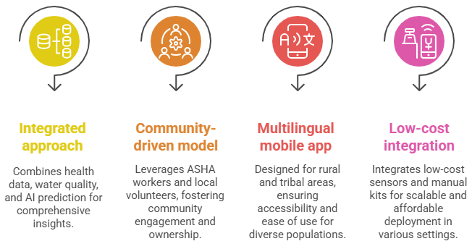
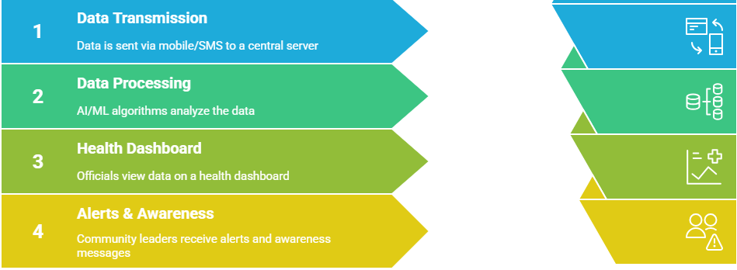
AQUASHIELD
Smart Health MONITORING & Early Warning System
FEATURE
FABRICATORS
Detailed Explanation of the Proposed Solution :
How It Addresses the Problem :
We propose AQUASHIELD: Smart Health Surveillance & Early Warning System that integrates AI/ML, IoT, and mobile technology to detect, monitor, and help prevent water-borne disease outbreaks in vulnerable communities.
Delays reduced: Early outbreak prediction helps deploy medical teams faster.
Accessibility improved: Tribal language support + offline mode.
Prevention enabled: Community awareness campaigns prevent disease spread.
Integration achieved: Combines health data, water monitoring, and AI predictions
Data Collection:
Mobile app/SMS reporting by clinics, ASHA workers, and volunteers.
IoT-based water quality monitoring (pH, turbidity, bacterial presence).
Manual entry from water test kits where sensors are unavailable.
Processing & Prediction:
  Centralized server with AI/ML outbreak prediction engine.
  Uses health data + water quality + seasonal trends to predict risks.
Alerts & Awareness:
  Sends real-time alerts to health officials, district authorities, and local governance bodies.
  Community awareness via multilingual mobile notifications & educational modules.
Visualization & Administration:
  Interactive dashboards for officials: hotspots, trend analysis, and intervention planning.
  Offline-first design for remote areas with sync when connected feature.
Innovation & Uniqueness
Integrated approach: Combines health data + water quality + AI prediction.
Community-driven model: Leverages ASHA workers & local volunteers.
Multilingual offline mobile app designed for rural/tribal areas.
Low-cost sensor + manual kit integration for scalable deployment.

Slide 3









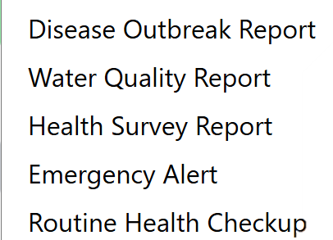


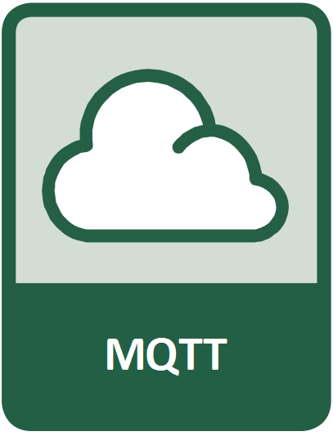





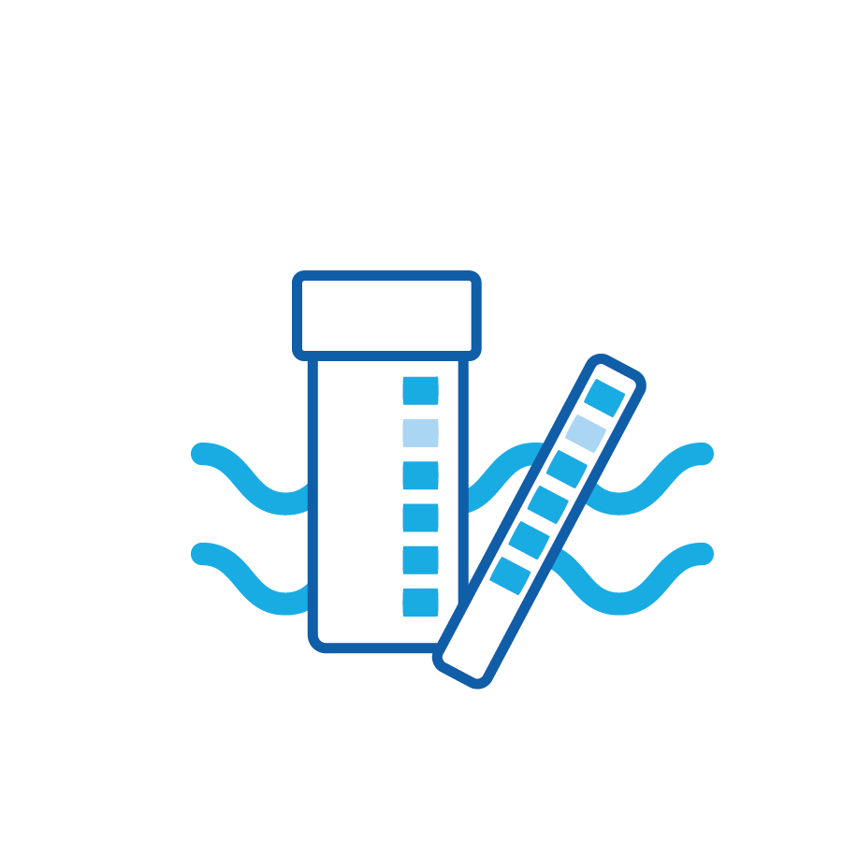
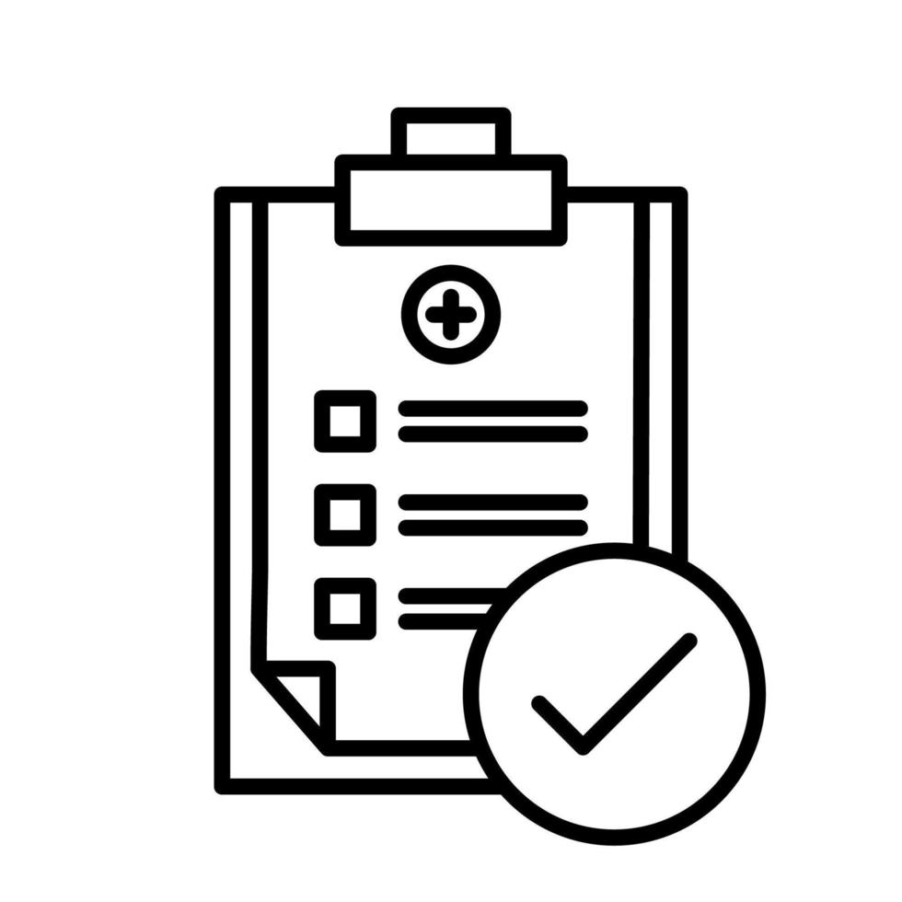


TECHNICAL APPROACH
FEATURE
FABRICATORS
Login/SignUp
Frontend/
Role base UI
Backend Node/Python
Backend System
Admin
> Volunteer
> Community member
Admin
Health official
Ai Agent
Health official
Asha Workers
User
Storage
* View all Analytics
* View Block Analytics
* View Village Analytics
* View Village Analytics
* View Personal Analytics
Server
Total Population
Health Workers
Critical Alerts
Water Quality Testing
Vaccinations
Total districts
Total villages
Notifications
Total block population
Critical alerts in block
Health workers
Area Coverage
Notification
Total village population
Active reports
Critical alerts in village
Area Coverage
Notification
Water Quality test
Vactination
Total village population
Active reports
Critical alerts in village
Area Coverage
Notification
Water Quality test
Vactination
Health score
Upcoming Appointments
Health tips
Nearby Services
Last checkup
Family members
Notifications
Frontend
AquaShield
Application
API
LLM
Tools
* Web Search Tools
* DB search Tools
User
* Block Management
> Volunteer
> Community member
Microservice System
Create villages
Assign workers ( asha, community members, volunteers )
Village management
* Village Reports
* Community reporting
* Family Management
* District Management
Health report
Add new Report
Report Disease or Water Sample
Upload Photo ( Disease or Water )
Add Family Members
Add Healt record
Report a disease
Asha Workers
Create District
Update District
Delete District
Flask Server
* Water Testing
Notification
/ Alerts
* Workers Management
Add water Test
Add water parameter and test water
Real time water quality detection
Upload image ( Evidance )
Asha workers Management
Community member
Volunteer Management
Temperature Sensor
Turbidity Sensor
ESP 32
* Patient Records
PH Sensor
* Health Programs
Patient Management ( Childrens, Adults, Pregnant Women )
Total Petients
Add new Patient
* Health observation
Other Water Quality Sensor
Database
Mongo DB
Collect health and water data
View health program data
Create and assign new health program.
Add Health observation of patients .
Add their health data
Voice interactivity
Temperature Sensor
* Block , Village and User Management.
Turbidity Sensor
ESP 32
* Health Queries
PH Sensor
Train For the Best Model
* Vaccination Tracking
Ask Question
Submit any queries
Other Water Quality Sensor
Vector
DB
*Report Generation
Health programs
Vaccination Management ( Total vaccination, Scheduled, Completed, Overdue )
Add New Vaccine
Schedule Vaccine
Image
Water Test Kit
Temperature Sensor
*Report Generation
Turbidity Sensor
ESP 32
Predict water Quality and disease Outbreak
Notification/ Alerts
Health Data
PH Sensor
ML Model
Submmit to Application
Other Water Quality Sensor
IOT
Network
* Health Survey
Temperature Sensor
Health survey report
New survey
Turbidity Sensor
ESP 32
Train the Model
ML
Water quality and disease reports
Water Quality
PH Sensor
Health reports
Predict OUTBREAKS
Other Water Quality Sensor
01
02
03
04
05
06
07
08
09
Frontend
Backend
Styling
Database
Microservice
ML
LLM
Vector DB
Deployment
* React
* React icon
* Zustand
* Express
* mongoose
* Cors
* Bcrypt
* JsonwebToken
* Mongo DB
* Python
* Flsak
* Django
* Scikit Learn
* TensorFlow
* Chroma
* Docker container
* AWS
* Tailwind Css
* Lucid react
* Gemini-2.5-pro

Slide 4
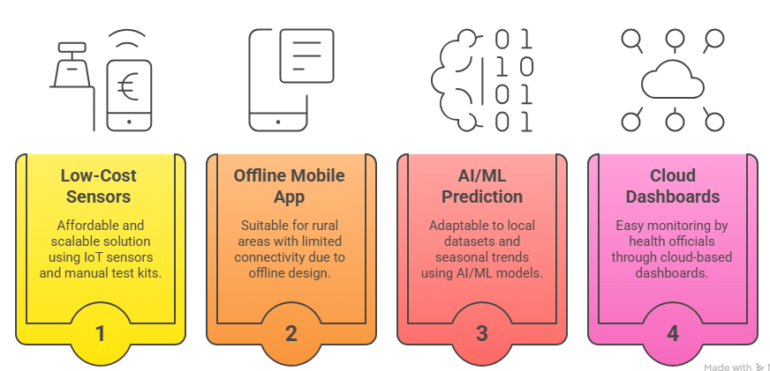
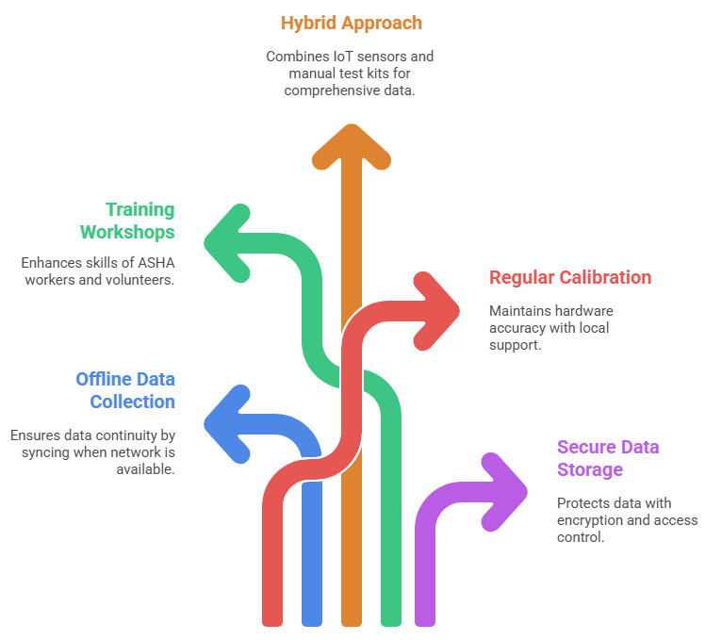
FEASIBILITY AND VIABILITY
FEATURE
FABRICATORS
Feasibility of the Idea💡
Strategies to Overcome Challenges🌐📶
Offline data collection with auto-sync when network available.
Training workshops for ASHA workers & volunteers.
Use of hybrid approach → IoT sensors + manual test kits.
Regular calibration & local technician support for hardware.
Secure data storage with encryption & role-based access.
Uses low-cost IoT sensors + manual test kits → affordable & scalable.
Mobile app with offline-first design → suitable for rural/tribal areas.
AI/ML prediction models → adaptable to local datasets & seasonal trends.
Cloud dashboards → easy monitoring by health officials.
Potential Challenges & Risks⚠️
Poor internet connectivity in remote villages.
Limited digital literacy among community members.
Inconsistent/manual data reporting from health workers.
Sensor maintenance & calibration issues.
Data privacy and security concerns.

Slide 5
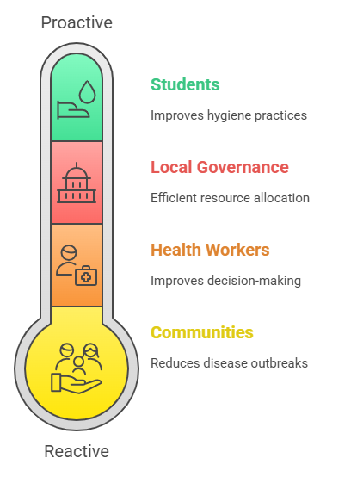
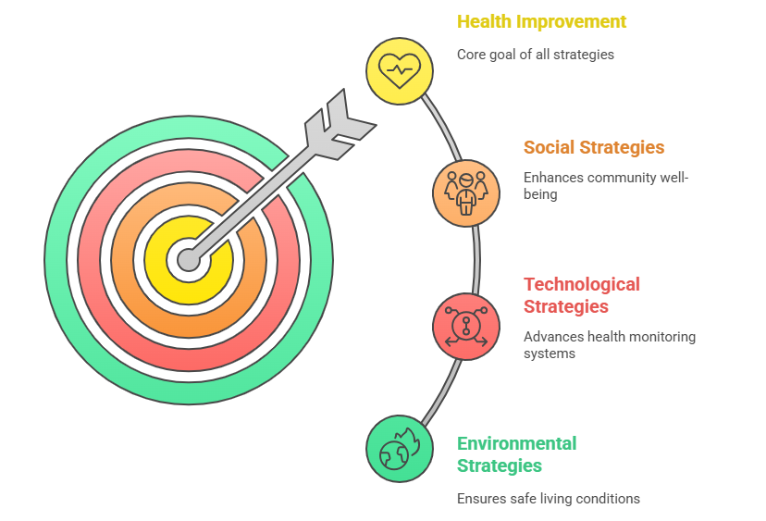
IMPACT AND BENEFITS
FEATURE
FABRICATORS
Potential Impact on Target Audience
Benefits of the Solution
Social: Reduces illness & mortality; improves quality of life
Technological: Builds AI-driven health monitoring infrastructure
Environmental: Encourages safe water practices; promotes sanitation

Slide 6
RESEARCH AND REFERENCES
FEATURE
FABRICATORS
Source | Title / Description | Year / Details | Link
WHO | Drinking-water Fact Sheet — facts about water, health, sanitation, hygiene. | Sep 2023 (World Health Organization) | https://www.who.int/news-room/fact-sheets/detail/drinking-water (World Health Organization)
UNICEF / JMP | Progress on household drinking water, sanitation and hygiene (WASH) – India and global | 2023 (UNICEF DATA) | https://data.unicef.org/resources/jmp-report-2023/ (UNICEF DATA)
United Nations | Goal 6: Water and Sanitation — global water issues | — (United Nations) | https://www.un.org/en/global-issues/water-and-sanitation/ (United Nations)
Research Paper | Empowering public health: Leveraging AI for early detection, treatment, and disease prevention in communities — scoping review in India | 2025 (PubMed) | https://pubmed.ncbi.nlm.nih.gov/40488301/ (PubMed)
Research Paper | AI-driven epidemic intelligence: the future of outbreak early warning — review of integrating real-time resource optimization, ED trends etc. | 2025 (Frontiers) | https://www.frontiersin.org/journals/artificial-intelligence/articles/10.3389/frai.2025.1645467/full (Frontiers)
Research Paper | Artificial intelligence in early warning systems for infectious disease surveillance — evaluates AI methods, data sources, benefits and challenges | 2025 (Frontiers) | https://www.frontiersin.org/journals/public-health/articles/10.3389/fpubh.2025.1609615/full (Frontiers)

